Slide 1

A Data-Driven Approach to Big Mountain Resort's Pricing

Slide 2

Problem Identification:
Pricing Strategy Misalignment
Current State: Market dynamics and customer expectations are not aligned with the current pricing model, $81 for AdultWeekend.
Balancing Act: Challenges exist in finding the right balance between affordability and profitability.
Strategic Realignment: The need for a strategic pricing realignment is crucial for sustained success.

Slide 3

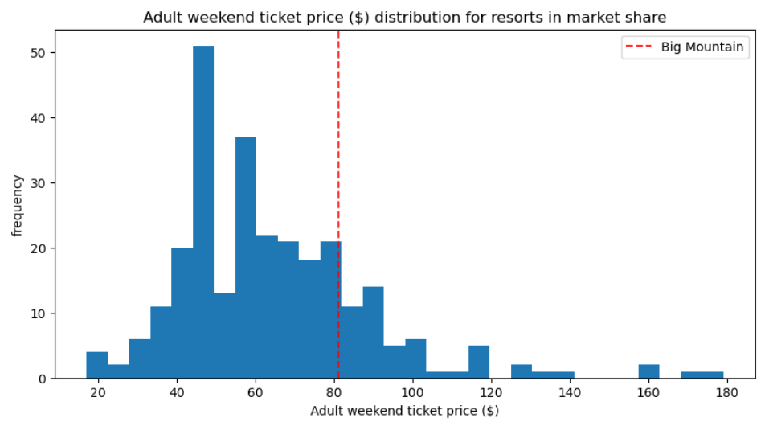
Problem Identification:
Competitive Landscape
Comparative analysis reveals significant pricing disparities compared to competitors.
Big Mountain Resort's unique features are undervalued in the current pricing strategy.
Customer demands indicate a need for a more informed and competitive pricing strategy.

Slide 4

Recommendation and Key Findings:
Strategic Pricing Adjustment
Recommended Scenario
adding a run,
increasing the vertical drop by 150 feet,
installing an additional chair lift.
Recommended Price
The modeling suggests that Big Mountain's facilities could support a higher ticket price in the marketplace. The estimated modelled price is up to about $83.
Over the season, this could be expected to amount to $3.474.638
The suggested increase aims to reflect the enhanced facilities and maximize profitability.

Slide 5
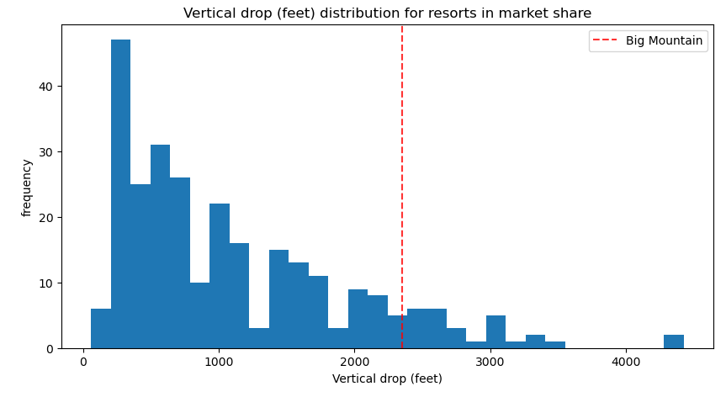
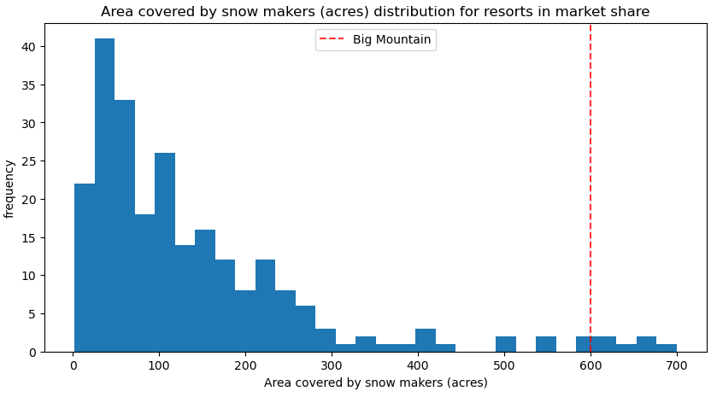
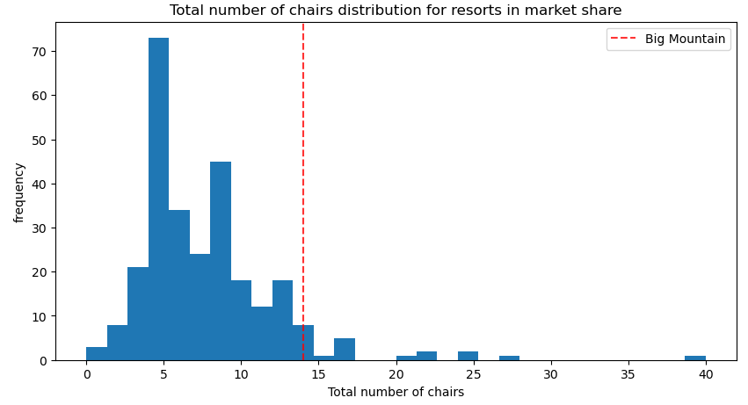
Modeling Analysis:
Competitive Features - I
Big Mountain is doing well for vertical drop, but there are still quite a few resorts with a greater drop.
Big Mountain is very high up the league table of snow making area.
Big Mountain has amongst the highest number of total chairs, resorts with more appear to be outliers

Slide 6
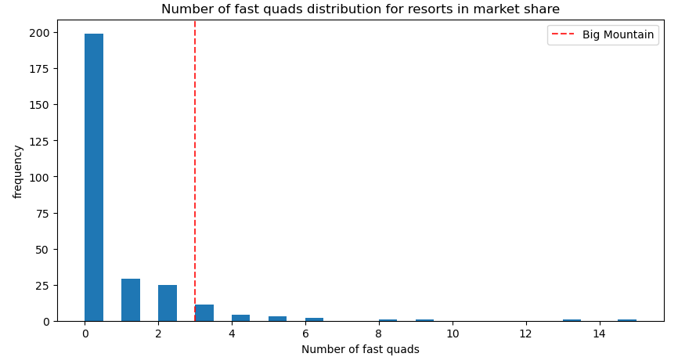
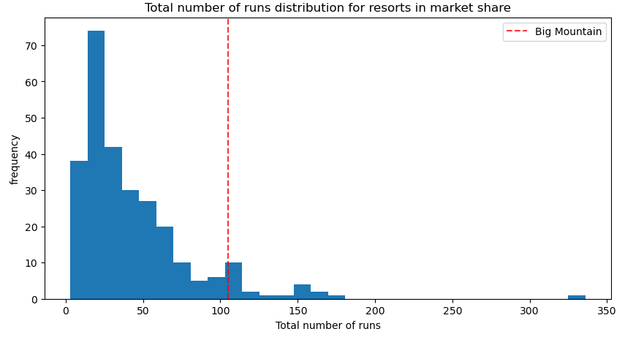
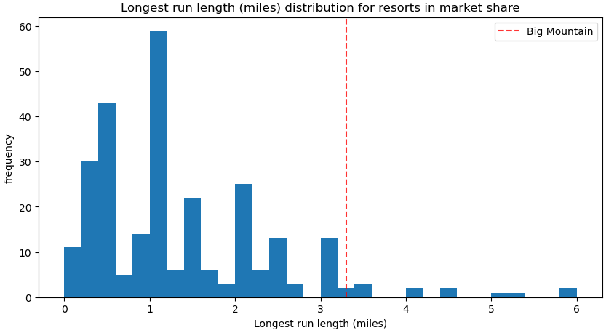
Modeling Analysis:
Competitive Features - II
Most resorts have no fast quads. Big Mountain has 3, which puts it high up that league table. There are some values much higher, but they are rare.
Big Mountain compares well for the number of runs. There are some resorts with more, but not many.
Big Mountain has one of the longest runs. Although it is just over half the length of the longest, the longer ones are rare.
Big Mountain is amongst the resorts with the largest amount of skiable terrain.

Slide 7
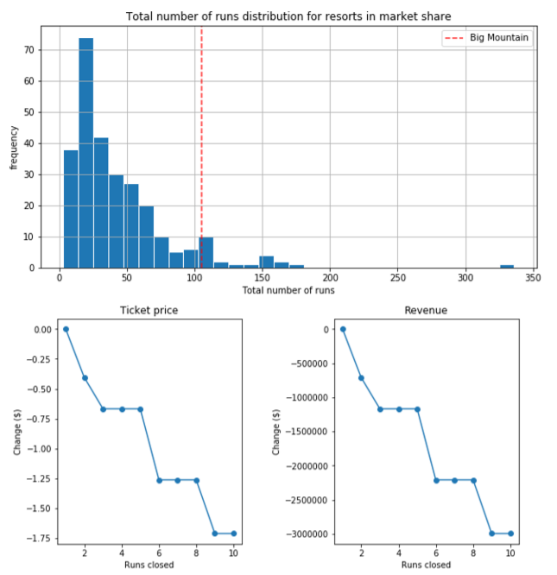
Modeling Results
Scenario 1 & Scenario 2
Scenario 1: Permanently closing down up to 10 of the least used runs.
The model says closing one run makes no difference. Closing 2 and 3 successively reduces support for ticket price and so revenue. If Big Mountain closes down 3 runs, it seems they may as well close down 4 or 5 as there's no further loss in ticket price. Increasing the closures down to 6 or more leads to a large drop.
Scenario 2: Increase the vertical drop by adding a run to a point 150 feet lower down but requiring the installation of an additional chair lift to bring skiers back up, without additional snow making coverage
This scenario increases support for ticket price by $1.99
Over the season, this could be expected to amount to $3.474.638

Slide 8
Modeling Results
Scenario 3 & Scenario 4
Scenario 3: Same as scenario 2, but adding 2 acres of snow making cover
Such a small increase in the snow making area makes no further gain in ticket price!
Scenario 4: Increase the longest run by 0.2 mile to boast 3.5 miles length, requiring an additional snow making coverage of 4 acres
No difference whatsoever. Although the longest run feature was used in the linear model, the random forest model (the one we chose because of its better performance) only has longest run way down in the feature importance list.

Slide 9
Summary and Conclusion:
Next Steps
The analysis indicates a justifiable increase in ticket prices, aligning with Big Mountain's improved offerings. However, careful consideration of market dynamics and customer sensitivity is crucial.
Future work should involve expanding the dataset to include detailed cost information beyond the new chair lift. Regular feedback sessions with business leaders can enhance the model's accuracy. Making the model user-friendly for business analysts will facilitate ongoing decision-making processes.
The following data can be provided to make the model more efficient:
historical information about revenue and facilities (particularly tracking facility changes) would have been very useful.
information about the operating costs of every aspect of the facilities that see high traffic would have been useful.
maintenance, labor, and utilities would be pivotal for a precise estimation of profit margins
incorporating additional revenue streams, such as equipment rental, lessons, or food services, could offer a more holistic understanding of the financial landscape.

